Slide 2
Protein sequencing
Protein sequencing is the practical process of determining the amino acid sequence of all or part of a protein or peptide.
This may serve to identify the protein or characterize its post-translational modifications.
Protein identification is the process of assigning a name to a protein of interest (POI), based on its amino-acid sequence.

Slide 3
The two major direct methods of protein sequencing are
Mass spectrometry
Edman degradation using a protein sequenator (sequencer).
Mass spectrometry methods are now the most widely used for protein sequencing and identification.
Edman degradation remains a valuable tool for characterizing a protein's N-terminus.
First step of any type of protein sequencing is the isolation or purification of protein by
1-SDS-PAGE (sodium dodecyl sulfate-poly acryl amide gel)
2-Two dimensional gels

Slide 4
Hydrolysis, separation and quantitation of Amino Acid
The number of each type of amino acid in a protein molecule can be determined by amino acid analysis.
The purified protein sample is hydrolyzed by heating in 6 M HCl at 110°C for 24 h in an evacuated sealed tube.
The resulting mixture is called hydrolysate containing amino acids.
The hydrolysate is subjected to ion exchange chromatography using a column of sulphonated polystyrene to isolate individual amino acids.
The isolated amino acids are then identified and quantified with the help of ninhydrin reaction.
Since the hydrolysate contains—amino acids, they produce blue colour, except proline which is an imino acid and produces yellow colour.
The amount of each amino acid in an unknown sample can be determined by absorbance (optical density) and comparing with that of known amount of standard sample of amino acid.

Slide 5
Edman degradation
Pehr Edman developed a process which is now used in Edman Sequenators, used for protein sequencing.
It can determine the first 10 or more residues using only a few picomoles of protein when 50-60 residues are available.
However, the necessary condition in this method is that the protein must have a free amino terminal.
The N-terminal residue is labelled with phenyl isothiocyanate and then it is cleaved from the rest of the peptide without breaking peptide bonds.
In Edman’s degradation, one residue at a time is sequentially removed from the N-terminal end and identified.
The amino terminal group is un-charged and therefore it reacts with phenyl isothiocyanate to form a phenylthiocarbamoyl derivative.
It is then released from rest of the protein in the form of a cyclic compound, called phenylthiohydantoin amino acid in mild acidic conditions.

Slide 6
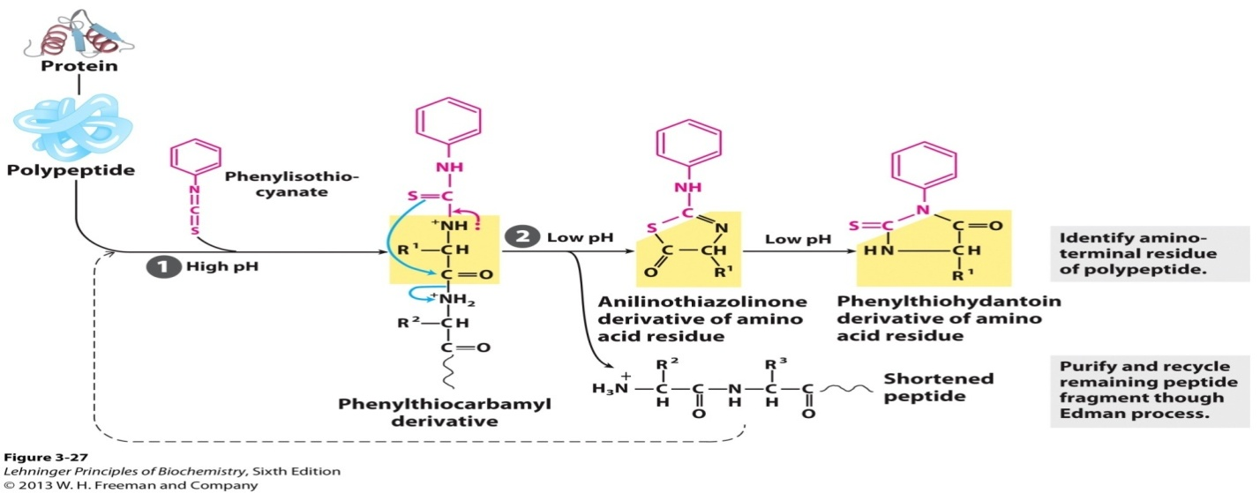

Slide 7
However, the remaining protein molecule remains intact with a free amino terminal for another cycle of phenyl isothiocyanate reaction.
The cyclic phenylthiohydantoin derivative of amino acid can be identified by high pressure liquid chromatography.
In this way, each amino acid can be identified one by one, requiring lot of time. Now the sequencing technique has been automated.
The problem arises when the protein molecule consists of higher number of amino acids, say a few hundred or more.
In order to sequence a larger protein, the initial step is to break it into smaller fragments to carry on Edman degradation.

Slide 8
Fragmentation of Amino Acids
To obtain smaller fragments of 20–100 residues, the first step is to digest protein molecule with endopeptidases having specific cleavage property.
The enzyme trypsin is highly specific for positively charged residues and it cleaves on the C-terminal side of arginine and lysine.
Similarly, chymotrypsin cleaves the peptide chain where C-terminal is contributed by aromatic amino acids phenylalanine, tryptophan and tyrosine.
Pepsin cleaves peptide bonds where N-terminal is donated by tryptophan, tyrosine, phenylalanine, leucine, aspartic acid and glutamic acid.
These peptide fragments obtained by enzymatic cleavage are separated by ion-exchange chromatography and then sequenced by Edman degradation.

Slide 9
Another method of partial hydrolysis of protein molecule is by exopeptidases which are specific for C-terminal cleavage.
Carboxypeptidase A cleaves all C-terminal bonds of tyrosine, tryptophan and phenylalanine, whereas Carboxypeptidase B cleaves C-terminal bond of arginine and lysine.
Carboxypeptidase C can cleave all free C-terminal residues. Although amino acid sequence of each fragment can be known, but the order of fragments in the polypeptide chain cannot be ascertained.
Chemical Fragmentation Method - Cyanogen bromide (CNBr) specifically cleaves Met residues at the C-end forming a homoserine lactone
Hence, it is necessary to generate overlapping fragments from the original protein.
Different chemicals or enzymes are needed for the purpose. Fragments generated by trypsin, chymotrypsin and cyanogen bromide may be used.
Chymotryptic peptides will overlap one or more tryptic peptides to establish sequence of fragments.

Slide 10
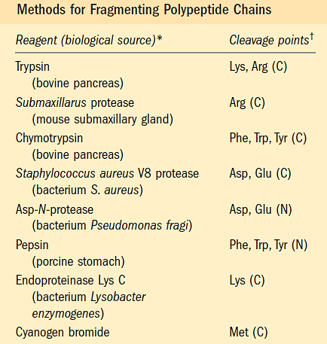

Slide 11
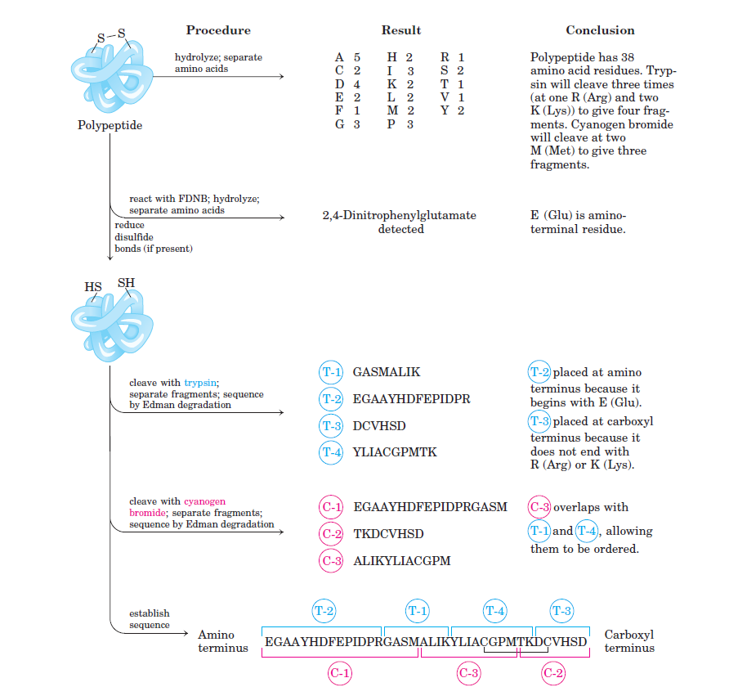

Slide 12
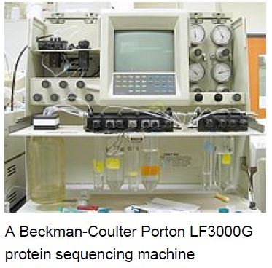
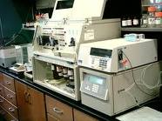
Automatic protein sequencers
Automatic protein sequencers are designed that perform the 3 steps
labeling, separation and analysis of amino acids at a time and analyze data and give results automatically
AUTOMATED DEVICE IS DEVELPED BY EDMAN and GEOFFREY BEGG

Slide 13
MASS SPECTROSCOPY METHOD
Mass spectrometry is an analytical technique used for identification and quantification of wide range of chemical and biochemical compounds.
The sensitivity of this technique allows detection of minor mass changes in the compounds allowing for their structural elucidation.
In MS, molecules are converted into gaseous phase ions and separated on the basis of their mass to charge ratio (m/z).
Successfully used to measure the mass of a wide range of macromolecules.
A solution of analytes is passed through a charged needle that is kept at a high electrical potential, dispersing the solution into a fine charged micro droplets.
This create a spectrum of species with different mass to charge ratios.
Each successive peak corresponds to a species that differs from that of its neighboring peak by a charge difference of 1 and mass difference of 1(1 proton) .

Slide 14
Protein sequencing by Mass Spectrometry
Mass spectrometry is an important emerging method for the characterization of proteins.
Mass spectrometer has three main parts for characterizing the protein –
1. Sample inlet – sample are introduced.
2. An ionization source – forms ions of the samples.
3. A mass analyzer – ions are separated in the according to their mass and charge.
4. An ion detector - detects the ion signals and amplifies them to data system.
5. Data system – obtain data in the form of spectrum.
The two primary methods for ionization of whole proteins are
electro spray ionization (ESI)
matrix assisted laser desorption/ionization (MALDI).

Slide 15
Mass Spectrometer Block Diagram
High Vacuum System
Ion
source
Mass
Analyzer
Data
System
Inlet
Detector

Slide 16
How does a mass spectrometer work?
Sample
Mass analyzer: separates ions
Ion source: makes ions
Mass spectrum: presents information

Slide 17
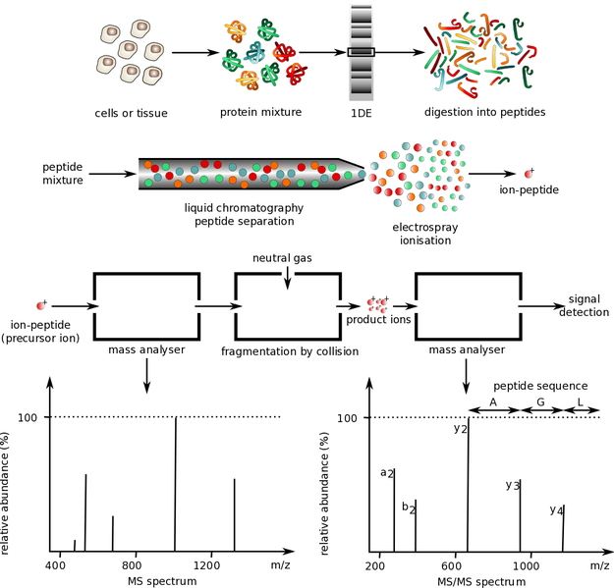

Slide 18
ADVANTAGES –
Stable isotopic labeling of proteins may be used to
discriminate between contaminants and original partners
using MS (mass spectrometry) techniques.
MS (mass spectrometry) has also made advantages in the
analysis of membrane proteins.
DIS-ADVANTAGES-
Miscalibration is one of the main errors of MS spectrometry.
MALDI doesn’t favor the identification of hydrophobic
peptides.

Slide 19
Applications of protein sequencing
Recombinant protein synthesis
Drugs production
Antibiotic production
Functional genomics
Determine the protein folding patterns
In bioinformatics
It plays vital role in proteomics
Used for the prediction of final structure, function and location of protein
To find out the location of gene coding for that protein

Slide 20
Protein catabolism or degradation
Protein catabolism or degradation is the breakdown of proteins into amino acids and simple derivative compounds.
Protein catabolism, which is the breakdown of macromolecules, is essentially a digestion process.
Protein catabolism is most commonly carried out by non-specific endo- and exo-proteases.
One example is the subclass of proteolytic enzymes called oligopeptidase.

Slide 21
Purpose
The primary reason for protein catabolism is so organisms can convert proteins into a form of energy that they can use or store.
To reuse their proteins, bacteria or microorganisms break down their proteins through protein catabolism into their individual amino acids and are used to form bacterial proteins or oxidized for energy.
The amino acids produced by catabolism may be converted into different amino acids, or can undergo amino acid catabolism to be converted to other compounds via the Krebs cycle.
The second reason is that for transport of proteins into the cell through the plasma membrane and ultimately for the polymerization into new proteins.

Slide 22
The proteins are digested in the intestines to produce the amino acids.
The proteins are continuously being broken down and reformed, depending on the current needs that the body has.
Proteins have different half-lives: some have an incredibly short half-life while others have longer ones.
Those with short life-lives are primarily used in metabolic pathways or processes because they help the cell adjust continuously and quickly to the changes that occur due to these processes.

Slide 23
There are some processes to convert amino acids into usable molecules to enter the TCA cycle, such as
Deamination (removal of an amino group)
Transamination (transfer of amino group)
Decarboxylation (removal of carboxyl group)
Dehydrogenation (removal of hydrogen)

Slide 24
Protein degradation
This first step to protein catabolism is breaking the protein down into amino acids by cleaving their peptide bonds, also known as proteolysis.
The peptide bonds are broken up by the proteasome, which is able to hydrolyze the peptide bonds by using ATP energy.
This process is further helped by the use of enzymes called proteases.
The proteases help cleave off the remaining peptide residues to produce individual amino acids, ready to be converted into usable molecules for either glycolysis or the TCA cycle, to produce energy for the organisms, or to be used to create new proteins.

Slide 25
Different types of proteases help cleave the proteins in different formats.
There are serine, aspartate, metalloproteases, and many other classes.
All use different mechanisms to cleave the peptide bonds to begin protein degradation.
For example, the serine proteases, such as trypsin, engage in a attack on the hydroxyl oxygen of the serine on the peptide bond's carbonyl carbon in order to cleave this bond.
On the other hand, for metalloproteases, such as zinc proteases, incorporate metals to break the bonds.
With zinc, its active site incorporates the zinc ion, water, and histidines (which are ligands to the zinc ion).

Slide 26
In certain organisms, such as bacteria, the proteins must undergo proteolysis before the amino acids can be re-polymerized into new proteins because the original proteins cannot pass through the bacterial plasma membrane, as they are too large.
After the proteins are broken down into amino acids through proteolysis, these amino acids will be able to pass through the membranes of bacteria and will once again congregate to form new proteins that the bacteria needs to function.

Slide 27
Amino Acid Degradation
Oxidative deamination is the first step to breaking down the amino acids so that they can be converted to sugars.
The process begins by removing the amino group of the amino acids. The amino group becomes ammonium as it is lost and later undergoes the urea cycle to become urea, in the liver.
It is then released into the blood stream, where it is transferred to the kidneys, which will secrete the urea as urine.
The remaining portion of the amino acid becomes oxidized, resulting in an alpha-keto acid.
The alpha-keto acid will then proceed into the TCA cycle, in order to produce energy.
The acid can also enter glycolysis, where it will be eventually converted into pyruvate.
The pyruvate is then converted into acetyl-CoA so that it can enter the TCA cycle and convert the original pyruvate molecules into ATP, or usable energy for the organism.

Slide 28
Transamination leads to the same end result as deamination: the remaining acid will undergo either glycolysis or the TCA cycle to produce energy that the organism's body will use for various purposes.
This process transfers the amino group instead of losing the amino group to be converted into ammonium.
Eventually, this product will also proceed into oxidative deamination to once again produce alpha-ketoglutarate, an alpha-keto acid that will undergo the TCA cycle, and ammonium, which will eventually undergo the urea cycle.

Slide 29
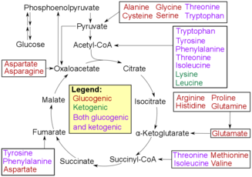

Slide 30
Factors Determining Overall Rate
Some key factors that determine overall rate include protein half-life, pH, and temperature.
Protein half-life helps determine the overall rate as this designates the first step in protein catabolism.
Depending on whether this step is short or long will influence the rest of the metabolic process.
One key component in determining the protein half-life is based on the N-end rule.
This states that the amino acid present at the N-terminus of a protein helps determine the protein's half-life.

Slide 31
Changes in the pH and temperature of the molecular environment can also help determine the overall rate.
The process that cleaves the protein's peptide bonds, proteolysis, is sensitive to changes in pH and temperature.
In low pH and high temperatures, proteolysis can begin even without an enzyme.
This would help speed up the overall rate since it yields the same results as adding an enzyme but without necessitating enzyme use.

